Slide 1
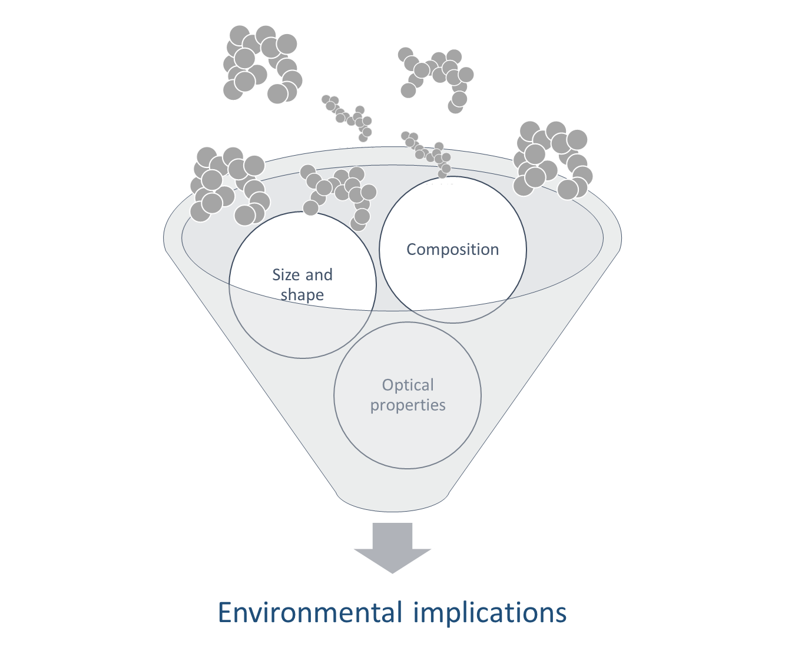
Meeting with Reza Kholghy (30th June)

Slide 2
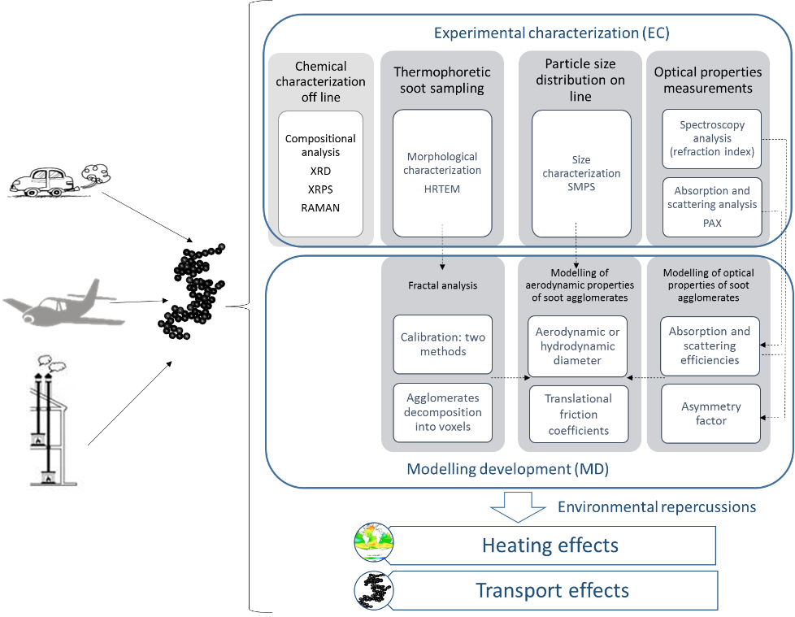

Slide 4
June 2021

Slide 5
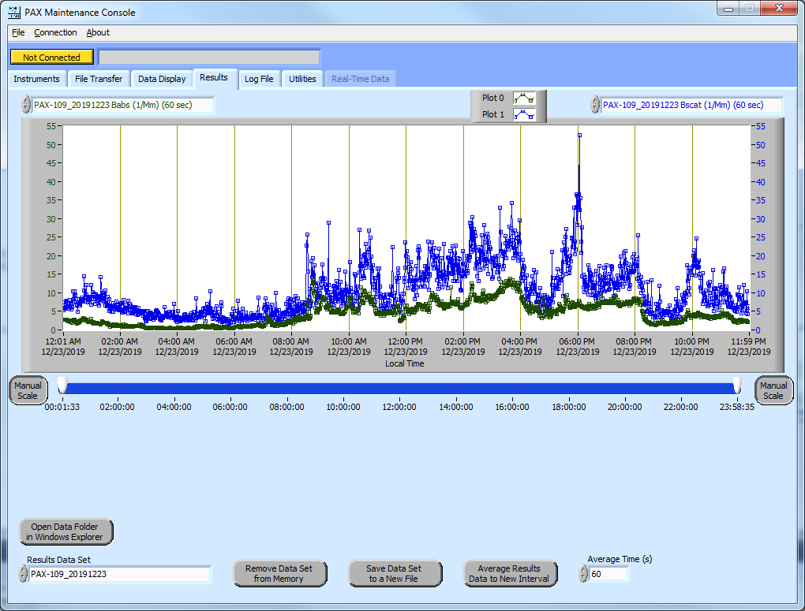
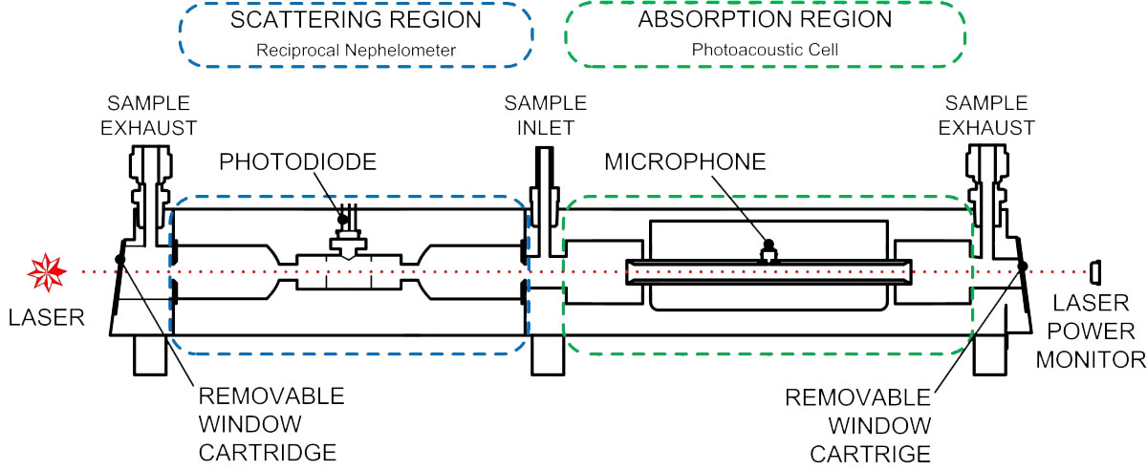
The three PAX measure simultaneously?
What are the practical requirements of the installation? Set up?

